Slide 1


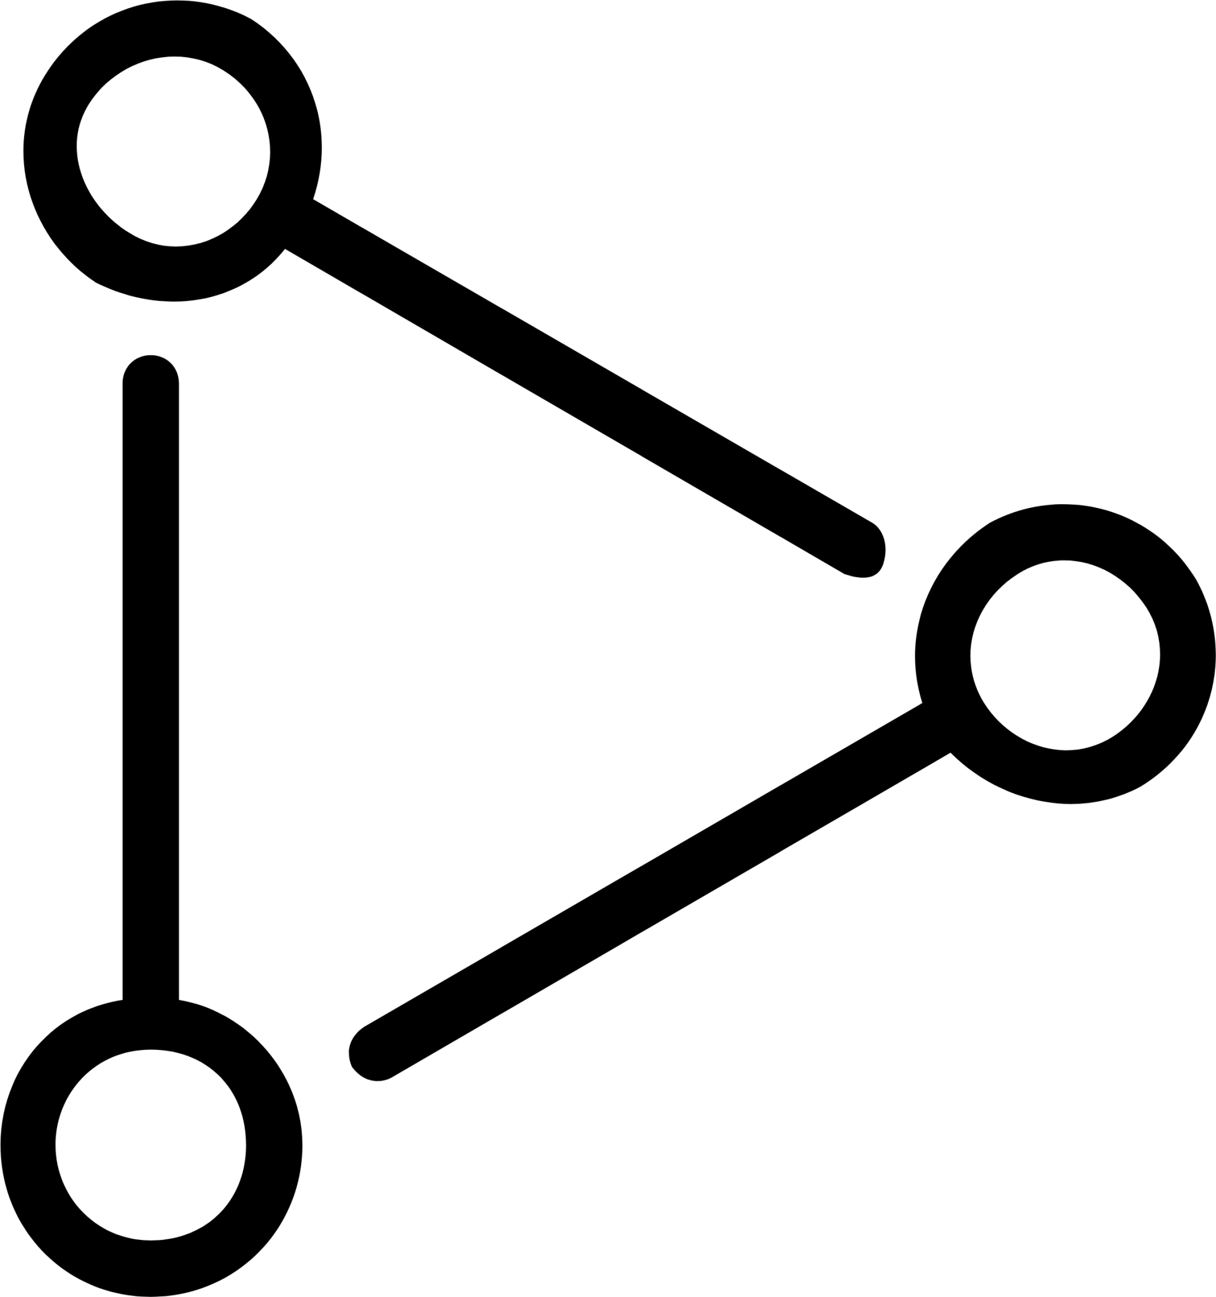

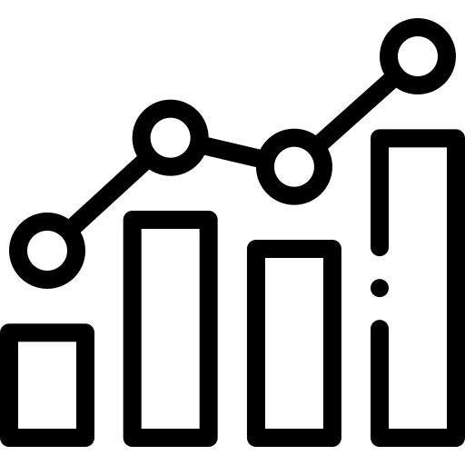
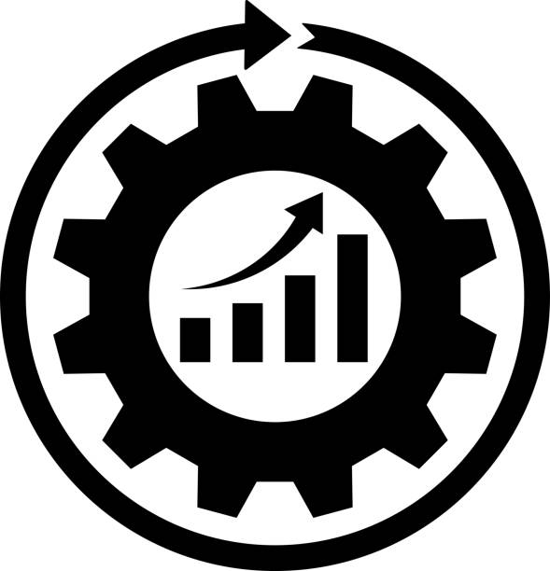

Team Old Monks
The Data Kraken
A Data Kraken refers to an advanced data integration and analytics system that captures, processes, and analyses vast amounts of data from various sources within a manufacturing firm.
Implementation Steps:
Data Collection
Data Integration
Analytics Platform
Visualisation
Continuous Improvement
#hackingforfuture | Team Old Monks

Slide 2
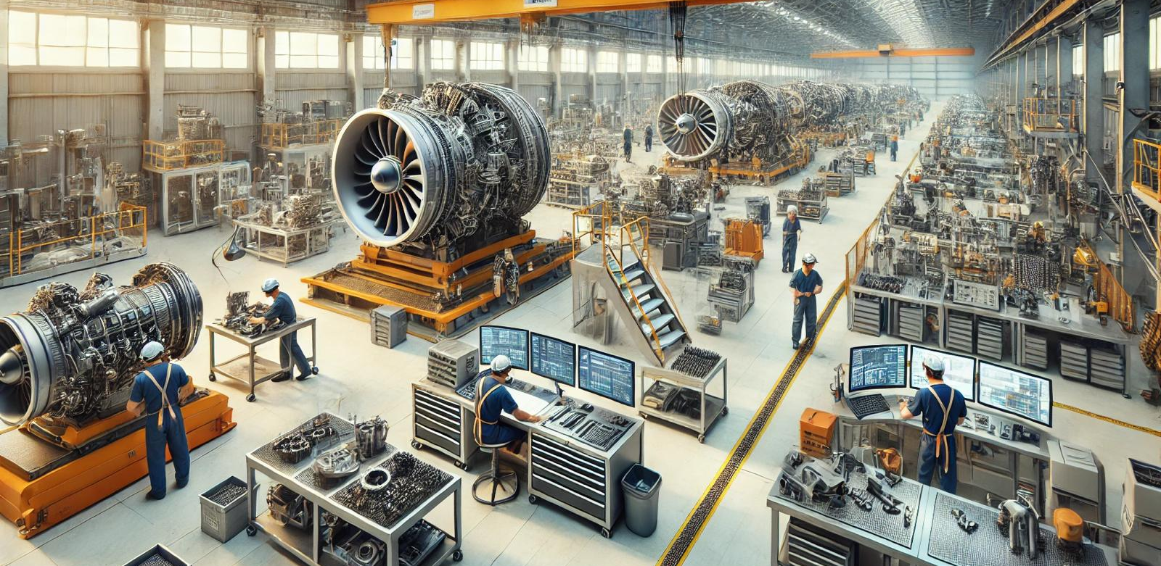
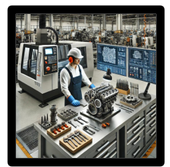

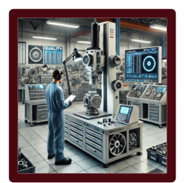

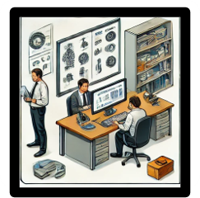
Aeroplane Engine Production Plant
Production
Maintenance
Upper Management Insights
Quality
HR
#hackingforfuture | Team Old Monks

Slide 3
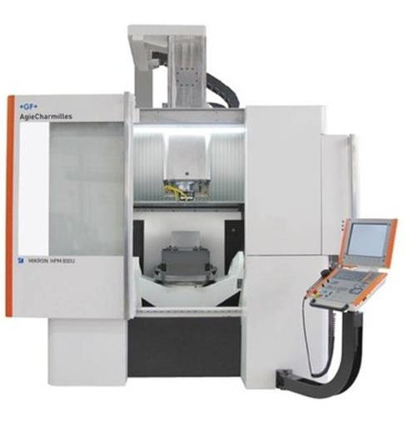
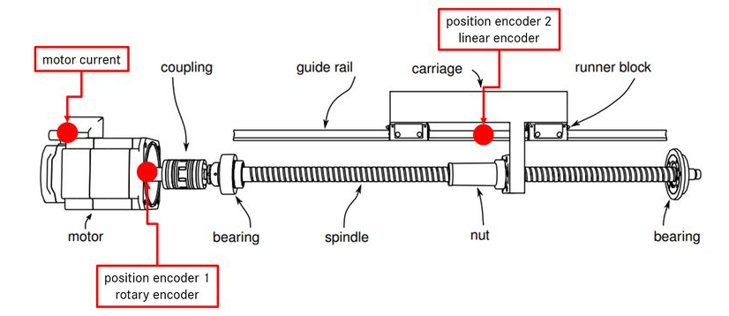
Problem Statement
Condition Monitoring for Predictive Maintenance of Tool Feed Drives
Objective:
Degraded Axes Identification – Automatically detect and trigger maintenance for degraded or underperforming axes.
Conditions to monitor:
Analysis Approach:
Axes Movement: Monitor movement from one software limit to the other at three different velocities.
Control Signals: Collect numeric control signals, position setpoints, and actual positions.
Motor Current: Measure motor current during operation.
Contour Deviations: Track deviations from the expected tool path.
Anomaly Detection: Identify axes showing anomalies through explorative data analysis
Movement Analysis: Differentiate forward and backward movement using position setpoints.
Feature Engineering: Calculate metrics like variance.
Data simplification: Use PCA and UMAP for dimensionality reduction.
Clustering: Apply HDBSCAN to group data points and detect outliers.
#hackingforfuture | Team Old Monks

Slide 4
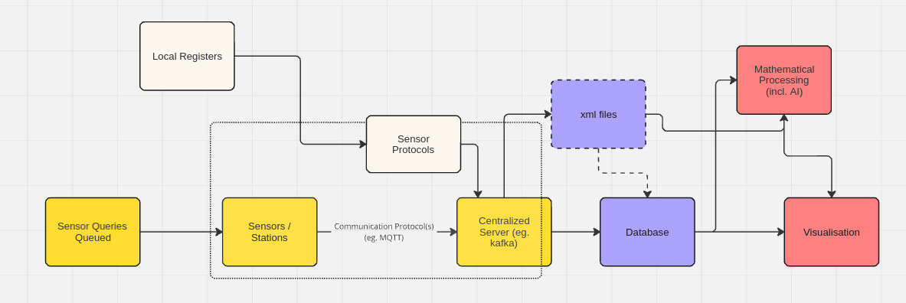



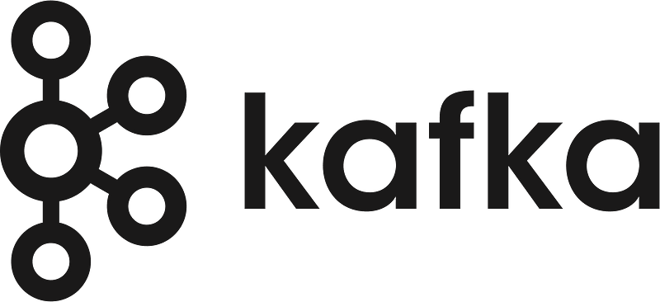

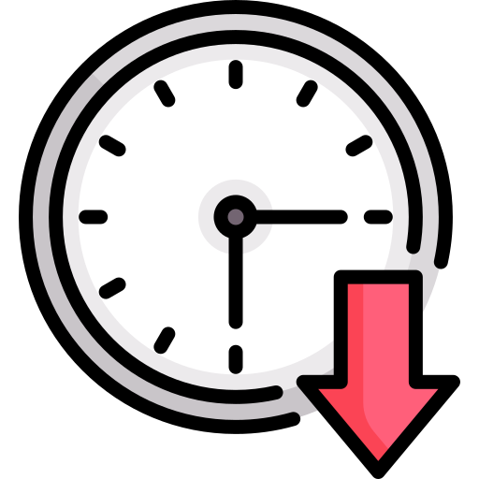


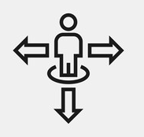
Benefits
Increased equipment lifespan
Reduced downtime
Cost savings
Improved productivity
Data-driven decision making
#hackingforfuture | Team Old Monks

Slide 5
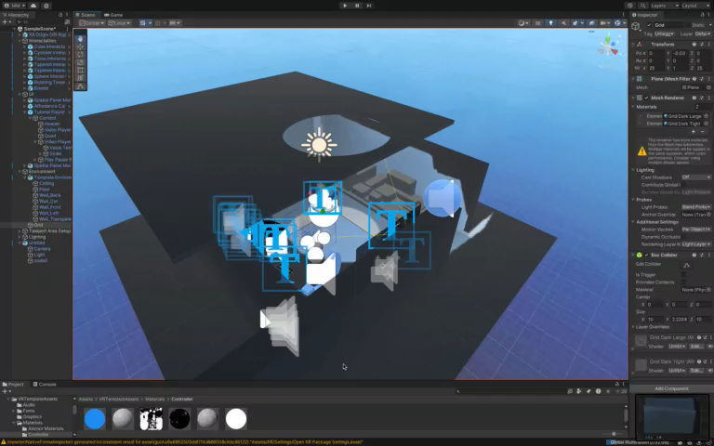
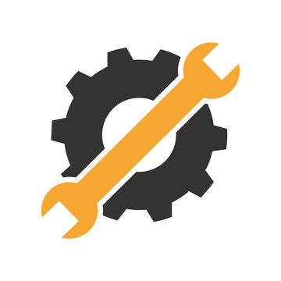


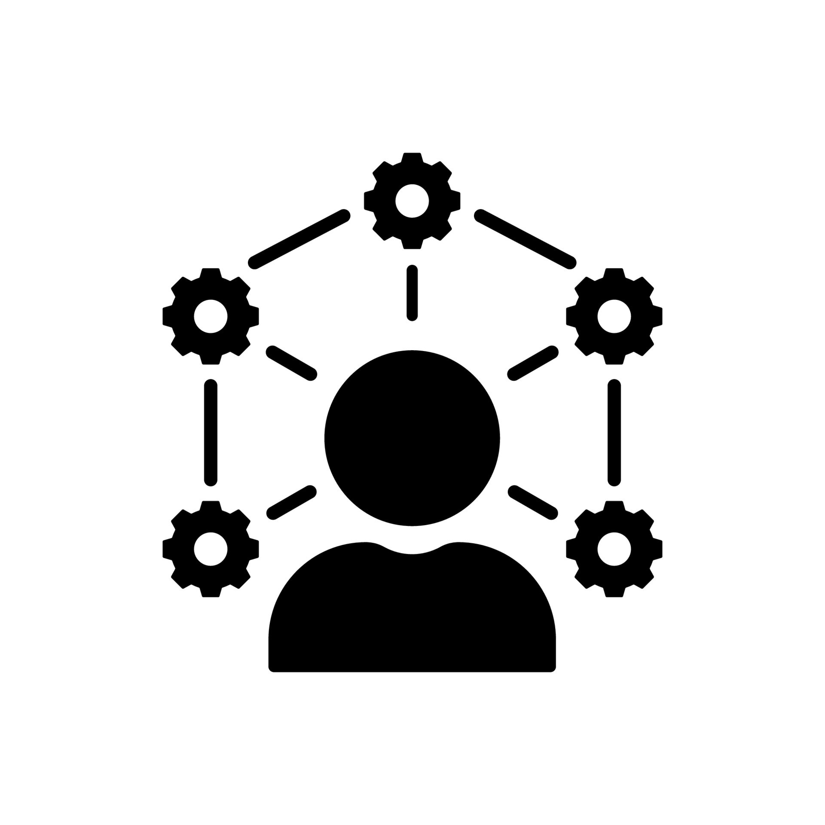
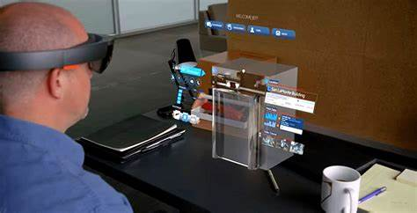

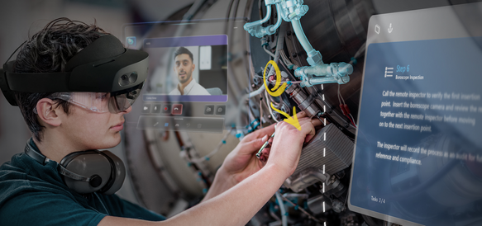
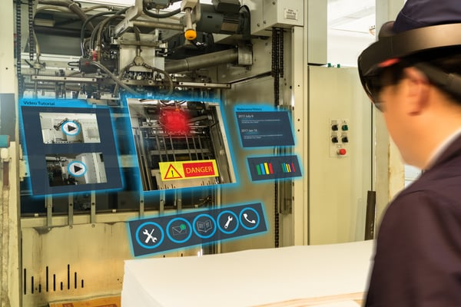
Our Addition
Integration of mixed reality for Reactive Maintenance
Mixed reality integrates virtual and physical environments to
assist technicians in real-time
troubleshooting and repairs
Enhanced Troubleshooting
Reduced Downtime
Improved Accuracy
Remote Assistance
Training & Knowledge Retention
Examples of remote support via MR
#hackingforfuture | Team Old Monks

Slide 6
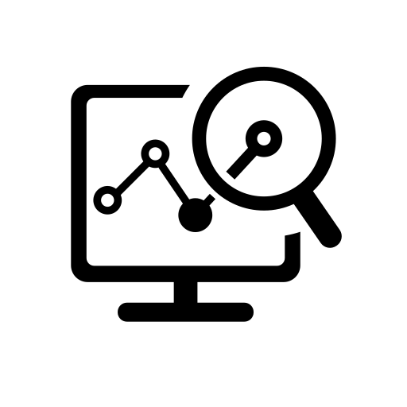
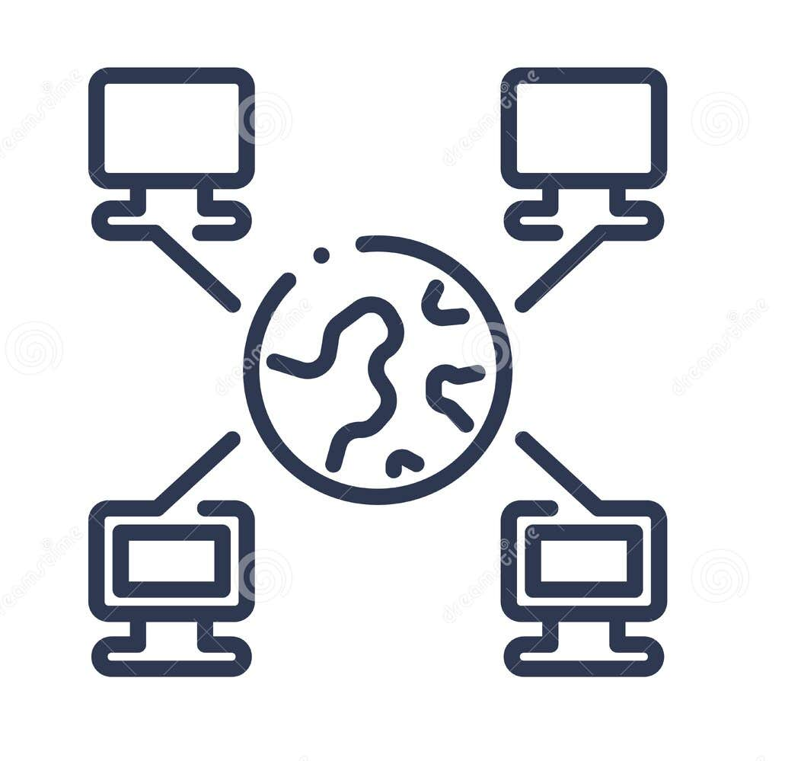


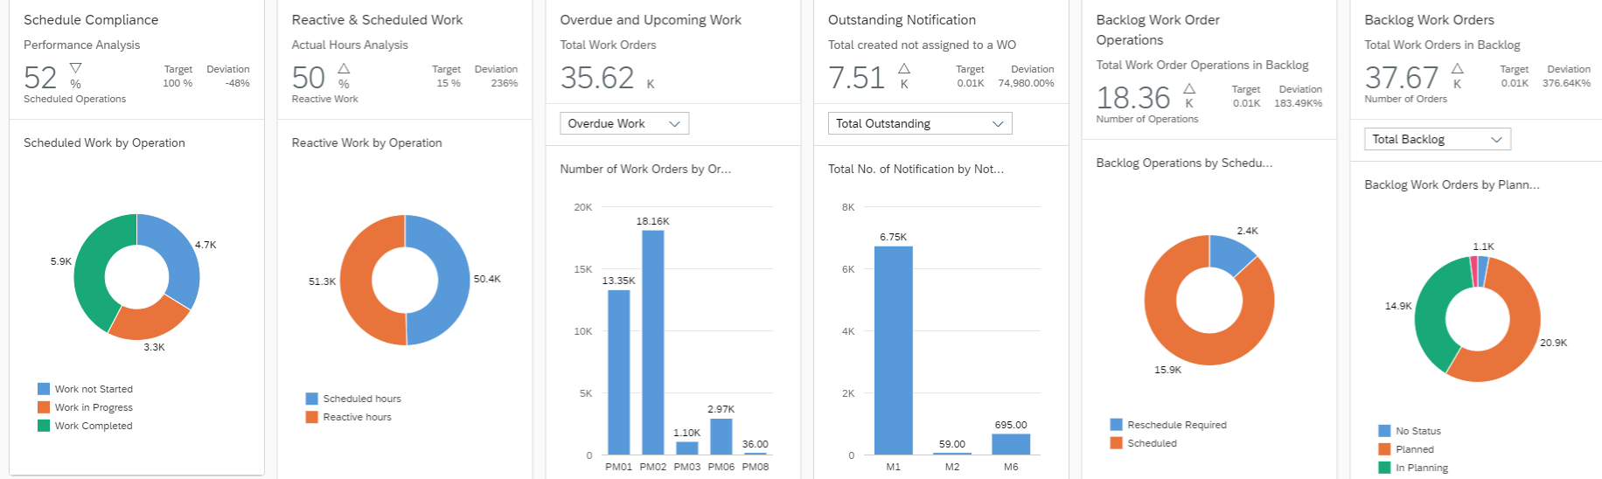
Kraken’s Use Case
Creating reports and real time dashboards for maintenance data
Increased ease of data visualisation
Remote viewing ability
Reduced reliance on paper based system
Increased compliance and safety
#hackingforfuture | Team Old Monks

Slide 7


Thank you!!
Team Old Monks:
- Anujoy Chakraborthy
- Manas Mehrotra
- Nikhil Myadam
- Rahul Kadam
s
#hackingforfuture | Team Old Monks

